Slide 1
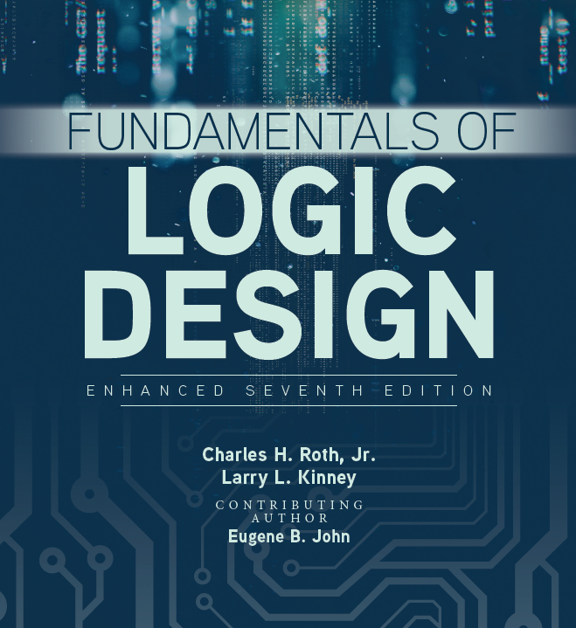

Unit 2
Boolean Algebra

Slide 2
This chapter includes:
2.1 Introduction
2.2 Basic Operations
2.3 Boolean Expressions and Truth Tables
2.4 Basic Theorems
2.5 Commutative, Associative, Distributive and DeMorgan’s Laws
2.6 Simplification Theorems
2.7 Multiplying Out and Factoring
2.8 Complementing Boolean Expressions

Slide 3
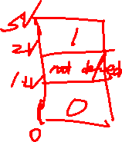
Introduction
All switching devices we will use are two-state devices, so we will emphasize the case in which all variables assume only one of two values.
Boolean variable X or Y will be used to represent input or output of switching circuit.
Symbols “0” and “1” represent the two values any variable can take on. These represent states in a logic circuit, and do not have numeric value.
Logic gate: 0 usually represents range of low voltages and 1 represents range of high voltages

Slide 4
Binary logic and gates
Interconnected transistors form logic gates
Each gate has inputs and an output. It performs a specific logical operation on its binary inputs and provides a binary value at the output
Inputs and output of a logic gate are designated by alphabetical variables
These variables can assume only 1 or 0 values and are known as binary variables
Three basic logical operations : AND, OR, and NOT

Slide 5

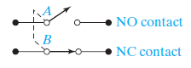
Basic Operations
The basic operations of Boolean (switching) algebra are called AND, OR, and complement (or inverse).
To apply switching algebra to a switch circuit, each switch contact is labeled with a variable. See diagram below:
NC (normally closed) and NO (normally open) contacts are always in opposite states.
If variable X is assigned to NO contact, then X’ will be assigned for NC.

Slide 6

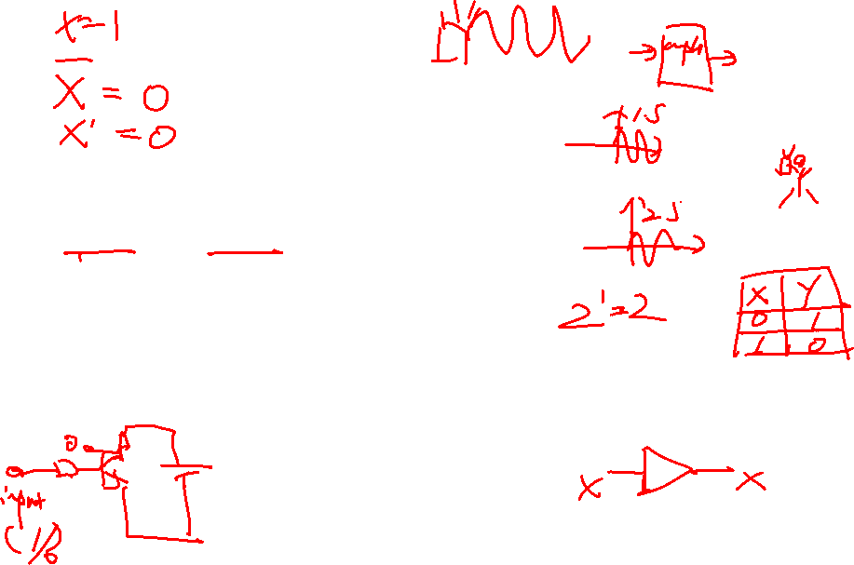
Basic Operations
Complementation/ Inversion:
Prime (’) denotes complementation.
0’=1 and 1’=0
For a switching variable, X:
X’=1 if X=0 and X’=0 if X=1’
Complementation is also called inversion. An inverter is represented as shown below, where circle at the output denotes inversion:

Slide 7
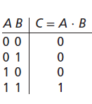
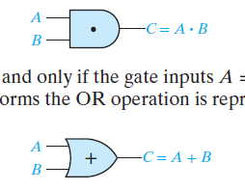

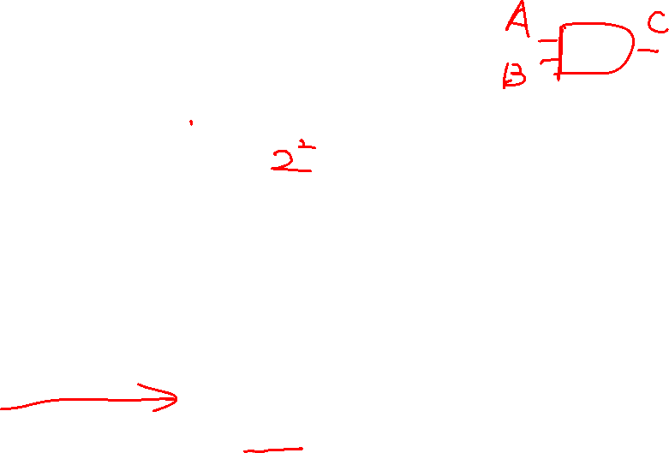
Basic Operations
Series Switching Circuits/ AND Operation:
Series:
Truth table B) Logic gate diagram
C) Switch circuit diagram
The operation defined by the table is called AND. It is written algebraically as C=A·B. We will usually write AB instead of A·B. The AND operation is also referred to as logical (or Boolean) multiplication.
A)
B)
C)

Slide 8
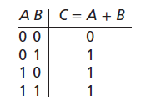

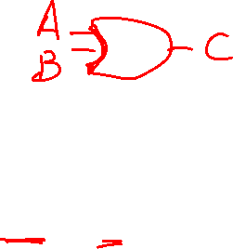
Basic Operations
Parallel Switching Circuits/ OR Operation:
Series:
A) Truth table B) Logic gate diagram C) Switch circuit diagram
The operation defined by the table is called OR. It is written algebraically as C=A+B. The OR operation is also referred to as logical (or Boolean) addition.
A)
B)
C)
If switches A and B are connected in parallel, there is a closed circuit if either A or B, or both, are closed and an open circuit only if A and B are both open.

Slide 9


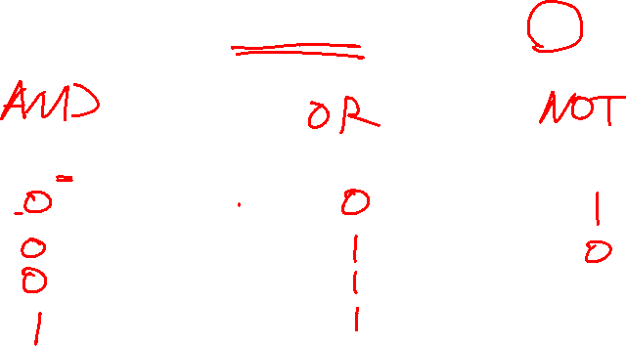
Truth tables
A Truth Table is a tabular form that uniquely represents the relationship between the input variables of a function and its output
A function F that depends on n variables will have 2^{n} rows
X | Y | 𝑍 = 𝑋 · 𝑌 | X | Y | X + Y
0 | 0 |  | 0 | 0
0 | 1 |  | 0 | 1
1 | 0 |  | 1 | 0
1 | 1 |  | 1 | 1
X | Z = 𝑿 '
0
1

Slide 10


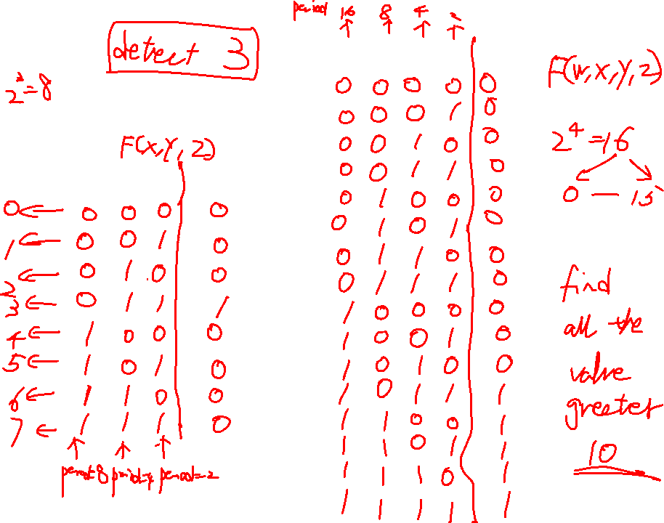
How to create a Truth tables
W X Y Z 𝐹
X Y Z F

Slide 11
Logic gates
Logical gates are electrical circuits that implement logical operations
The input terminals accept voltage signals within allowable range (as a binary signal) and gives out at the output terminal a binary signal that also falls with in the allowable range
Intermediate values are crossed only during transitions from 0 to 1 or otherwise

Slide 12
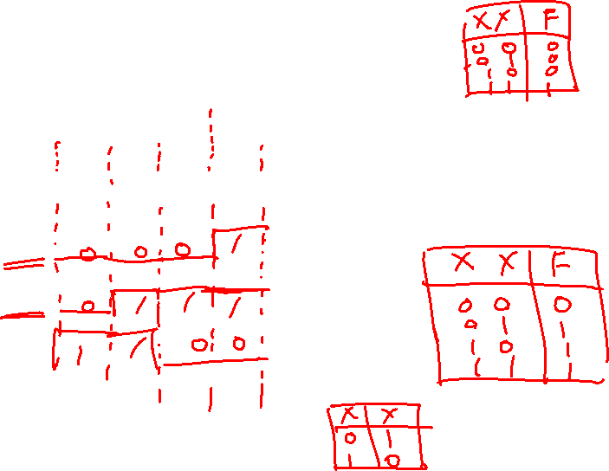
 | X | 0 | 0 | 1 | 1
 | Y | 0 | 1 | 0 | 1
(AND) (OR) | X ∙ Y X + Y
(NOT) | X'
Time diagram shows waveform behavior

Slide 13
Statements: TRUE is denoted as 1, FALSE is denoted as 0. Operators: >, >=, <, <=, ==, ~=, &(and), |(or), ~(negate) 10.Define x = 4, ~((x<=5) & (x~=5)) 11.Define Ficoscore = 700, Latepayment = 1. The card will be approved if Fico score is greater than 650 and no latepayment.

Slide 14
